Slide 1

Image Viewer- Full Stack Project
Django | Flask | ReactJS | RabbitMQ

Slide 2
Advance Full Stack
Name:
Vishal Chaurasiya
Aryan Patil
Mentor: Mr. Iyer

Slide 3
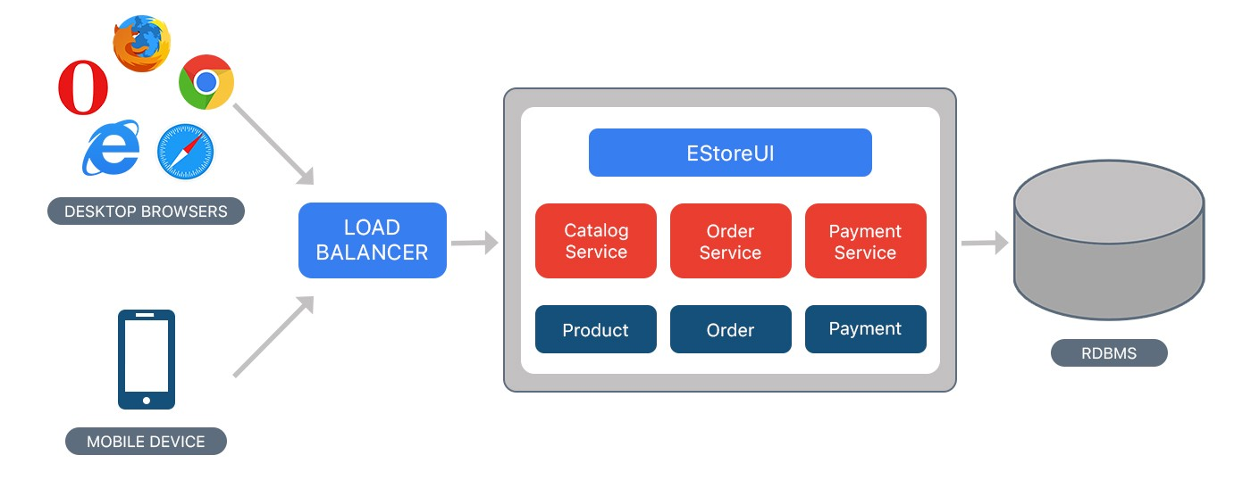
What is Monolithic Application
A monolithic application is a traditional model of a software program, which is built as a unified unit that is self-contained and independent from other applications.

Slide 4
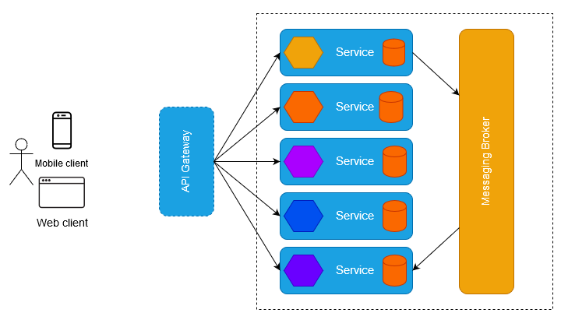
What is Microservices Architecture
A microservices architecture involves smaller applications deployed independently as loosely coupled services, tied together through application integration.

Slide 5
RabbitMQ
RabbitMQ is a Message broker.
Message broker is a piece of software, which enables services and applications to communicate with each other using messages. The message structure is formally defined and independent from the services that send them.

Slide 6
ReactJS
React is a JavaScript library for building user interfaces.
React is used to build single-page applications.
React allows us to create reusable UI components.

Slide 7
Role of User & Admin
Role of User : view, like
Role of Admin : CRUD operation → can add, view, update, delete the picture and name of the pictures

Slide 8
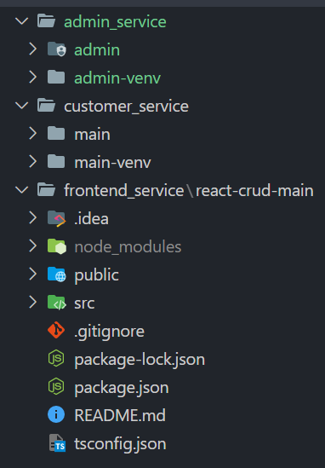
Code Structure
NOTE: The complete code is availible on github repository:
https://github.com/vishal8github/MicroArch-P4

Slide 9
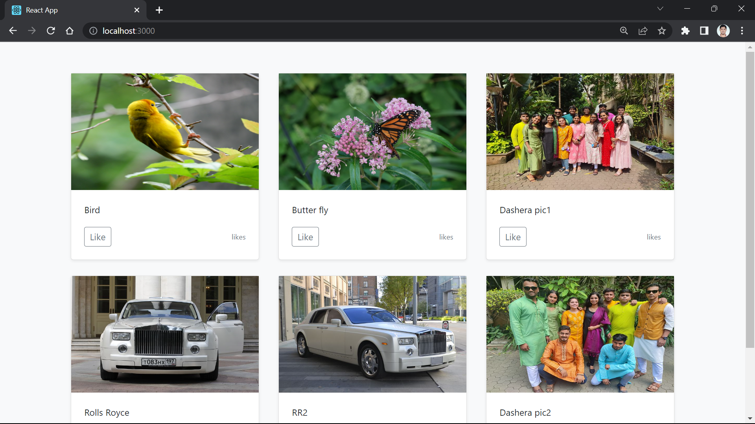
User Interface

Slide 10
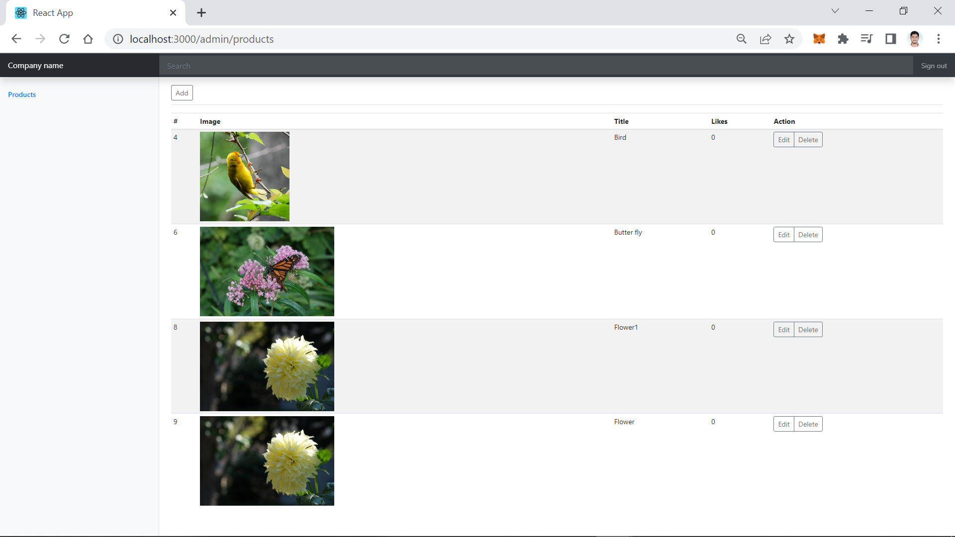
Admin Interface

Slide 11
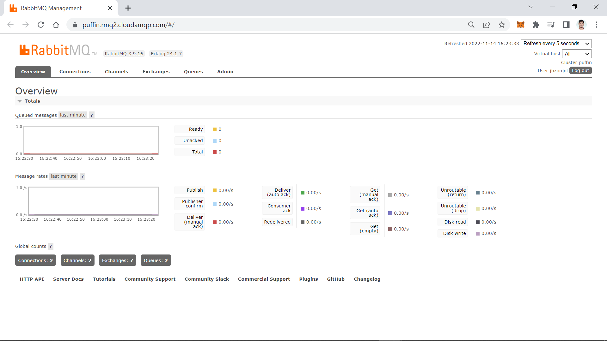
AMQP Interface

Slide 12
Thank you

